Slide 1
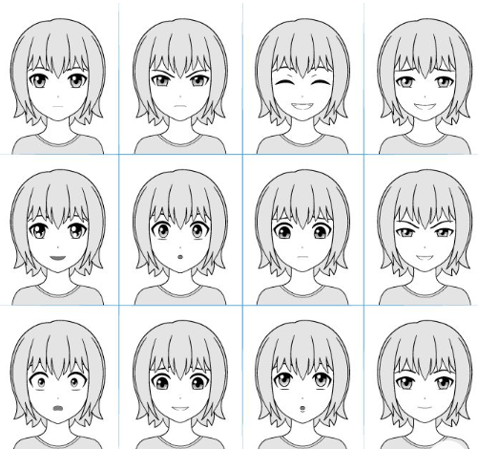
Facial Emotion Recognition
By
Leela Srija Alla
Pavan Kalyan Nayak
Vishnu Teja Jampala

Slide 2
Introduction
The objective is to classify each face based on the emotion shown in the facial expression into one of seven categories. We have used 7 emotions namely - Angry, Disgust, Fear, Happy, Neutral, Sad, Surprise.
As technology advancing and interactions between humans and machines becoming more frequent, recognizing facial expressions is crucial because it enhances communication between humans and machines.

Slide 3
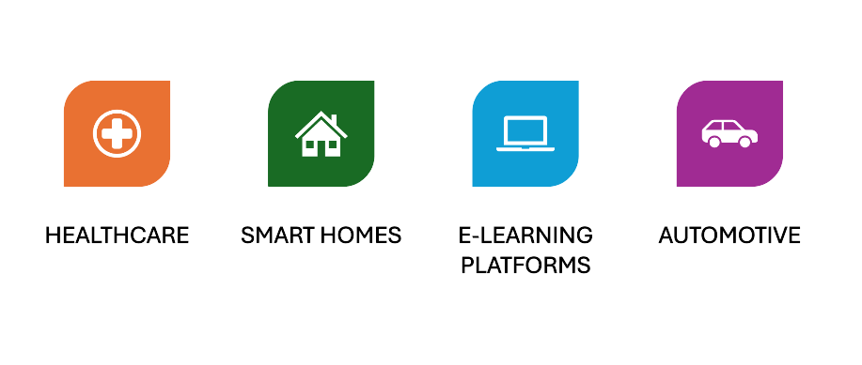
Applications in real world

Slide 4
Dataset : FER-2013
The dataset comprises 48x48 pixel grayscale images of faces, standardized to ensure each face is centered and occupies a consistent amount of space, enhancing the uniformity of the input data for emotion classification.
It labels faces with one of seven emotional expressions:'happy': 0, 'sad': 1, 'angry': 2, 'disgust': 3, 'fear': 4, 'surprise': 5, 'neutral': 6
Contains a total of 32,298 facial images, split into 28,709 training examples for developing the model, and 3,589 test examples for evaluating its performance in real-world scenarios.

Slide 5
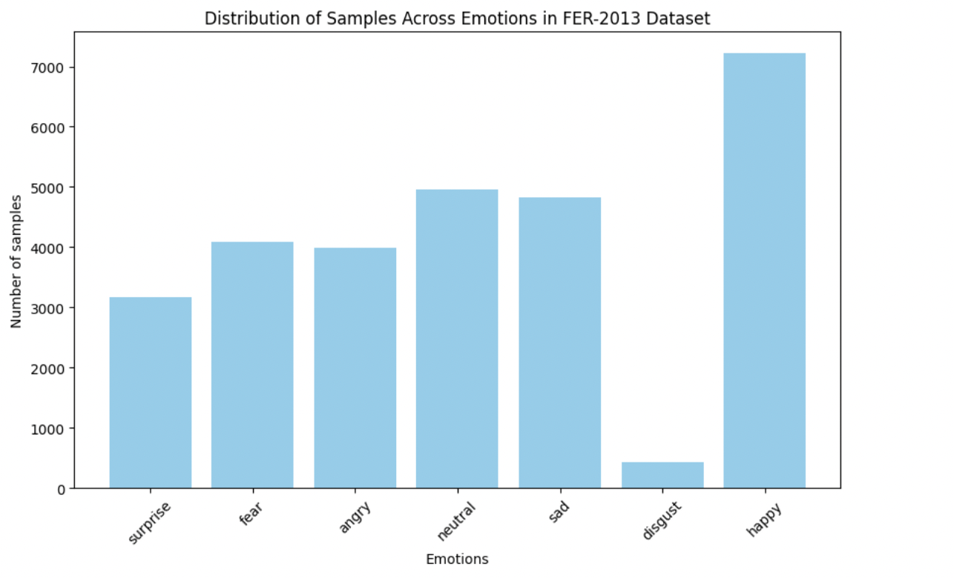
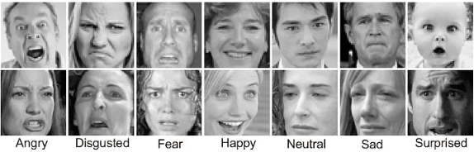
Dataset : FER-2013
Input images
Data distribution of Training set

Slide 6
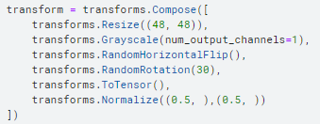
Data Transformation
Images are resized to 48x48 pixels, converted to grayscale to reduce complexity, and augmented with random horizontal flips and rotations up to 30 degrees to enhance the model's ability to generalize across different facial orientations.
Images are transformed into tensors and normalized using specific mean and standard deviation values, ensuring consistent input scales for optimal neural network performance.

Slide 7
Model Architecture

Slide 8
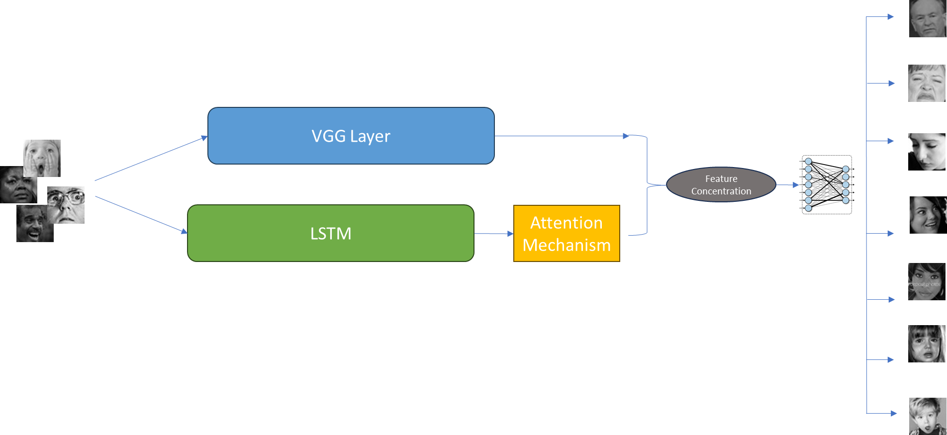
Loss function - Cross entropy with weight decay - 0.0001
learning rate - 0.0001
Optimizer - AdamW

Slide 9
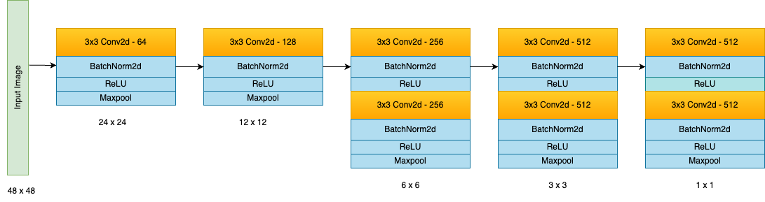
VGG Layer
The VGG network is a deep convolutional neural network, renowned for its uniform architecture of sequentially stacked convolutional layers.
Multiple sets of convolutional layers, each followed by a batch normalization and ReLU activation to enhance non-linearity and stabilize training. These layers incrementally increase in depth from 64 to 512 channels, extracting increasingly complex features from the input.

Slide 10
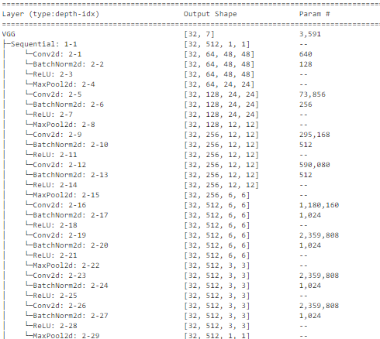
VGG Layer
Pooling Layers:
Max Pooling: Applied after convolutional layers to reduce spatial dimensions, thereby decreasing computational complexity and overfitting by abstracting the input features.(kernel_size = 2, stride = 2)

Slide 11
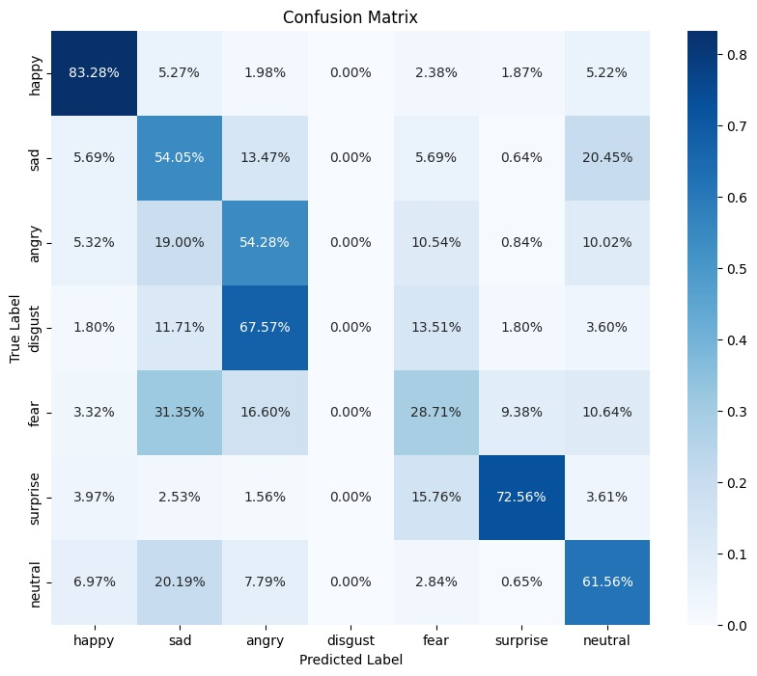
Confusion Matrix with VGG19
High Accuracy for 'Happy' and 'Surprise': indicating strong predictive power for these categories.
Confusion Between 'Fear' and 'Sad': 'Fear' is often confused with 'Sad' (31.35% misclassified as 'Sad').
Difficulty with 'Disgust' - less training data for this class

Slide 12
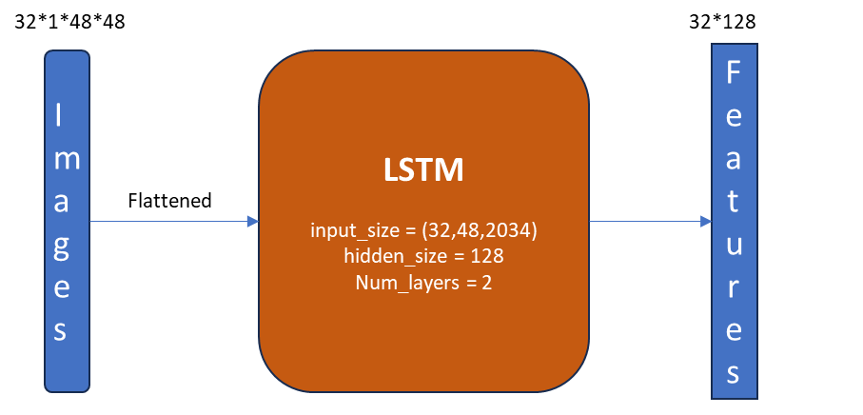
LSTM:
For capturing Temporal features
LSTMs divide an image into sequences to create a pseudo sequential structure to interpret the image as a sequence, identifying the temporal features.
The image tensor of size(32,1,48,48) is flattened to (32,48,2304) for LSTM input
The output of LSTM, the output features(h_t) from the last layer is concatenated with VGG features.

Slide 13
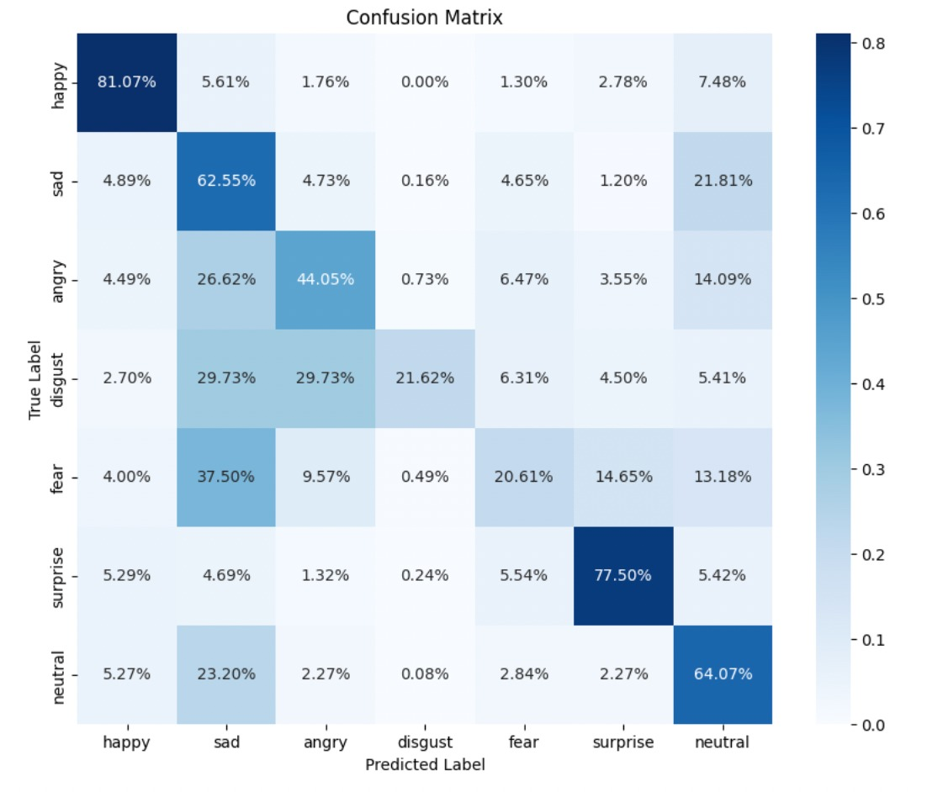
Confusion matrix with VGG + LSTM

Slide 14
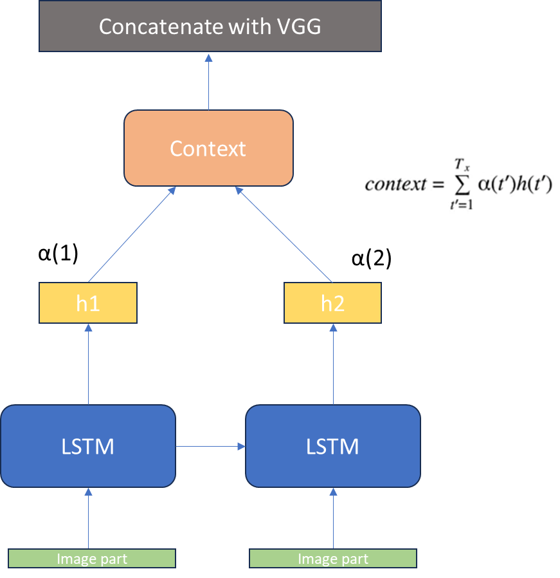

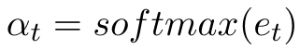
LSTM with Attention
It improves the model’s classification to focus on essential features.
It weighs the importance of different sequential input data parts to attend to selectively relevant features.
Calculate context vector and concatenate with VGG features to capture temporal features

Slide 15
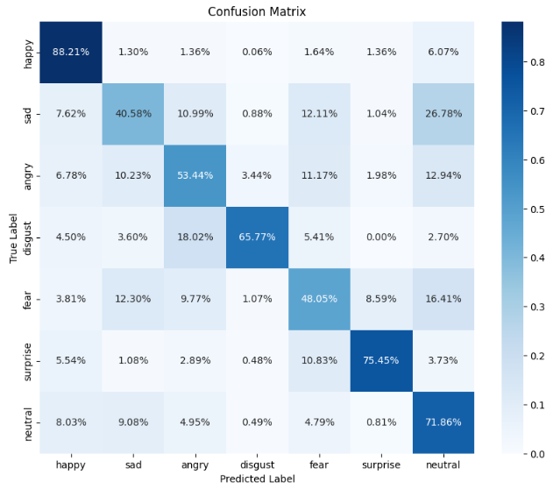
Confusion matrix with VGG + LSTM + attention

Slide 16
Experiments
We experimented with 3 learning rates - 0.0001, 0.001, 0.0005
Tried with optimizers - Adam, SGD, AdamW
Loss functions - started with Cross Entropy from literature. Tried with focal loss with gamma = 2, alpha = 0.1 as there is imbalance is classes.
Added Dropout Layers after Maxpool Layer with p = 0.2
Cross Entropy loss with learning rate - 0.0001, 0.001 and with and without weight decay. Weight decay = 0.001, 0.0001

Slide 17
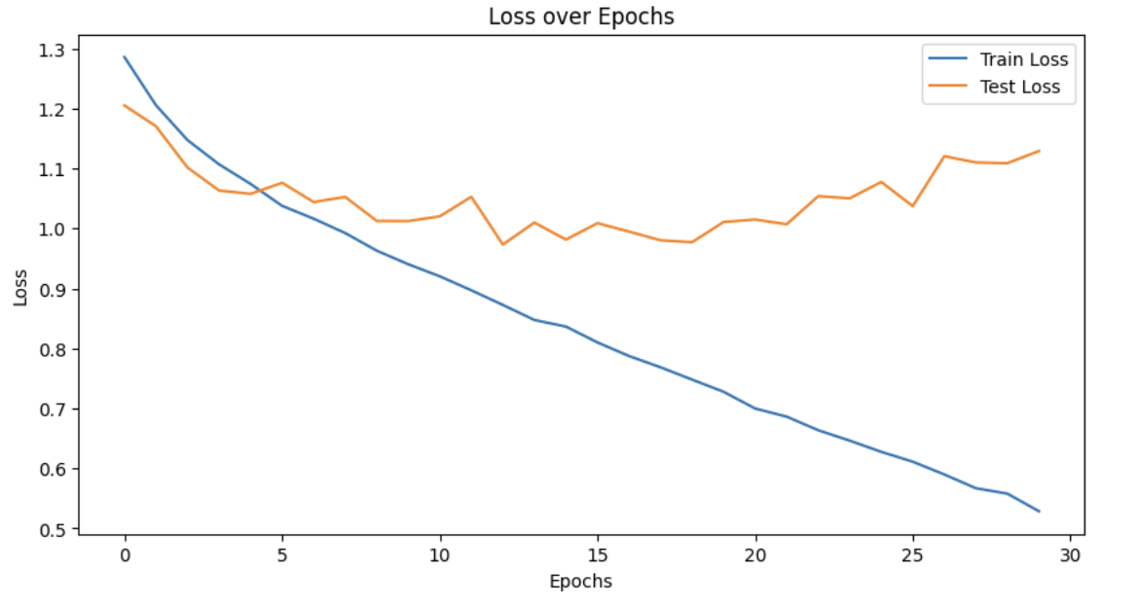
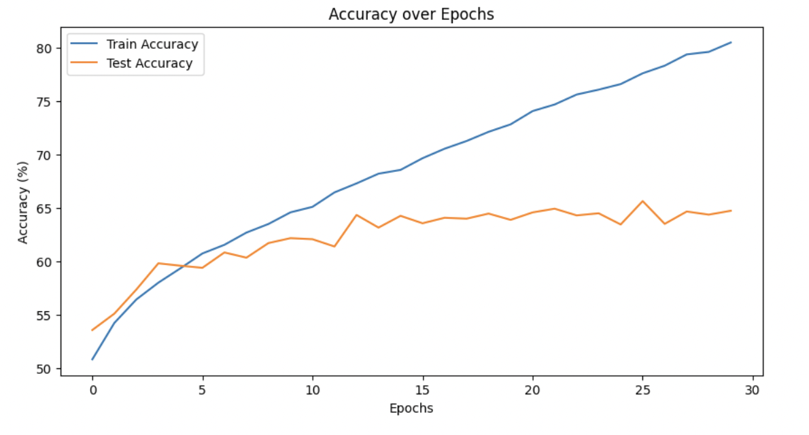
Results
Accuracy - 65.99 %

Slide 18
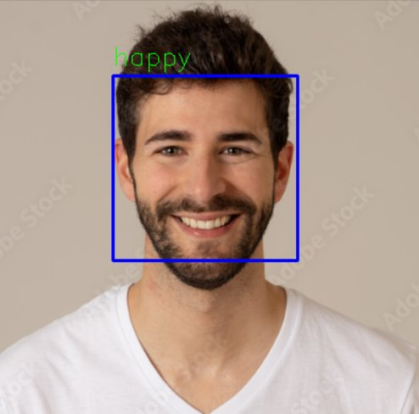
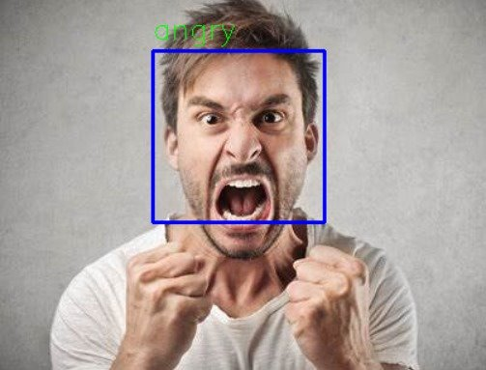
Results

Slide 19
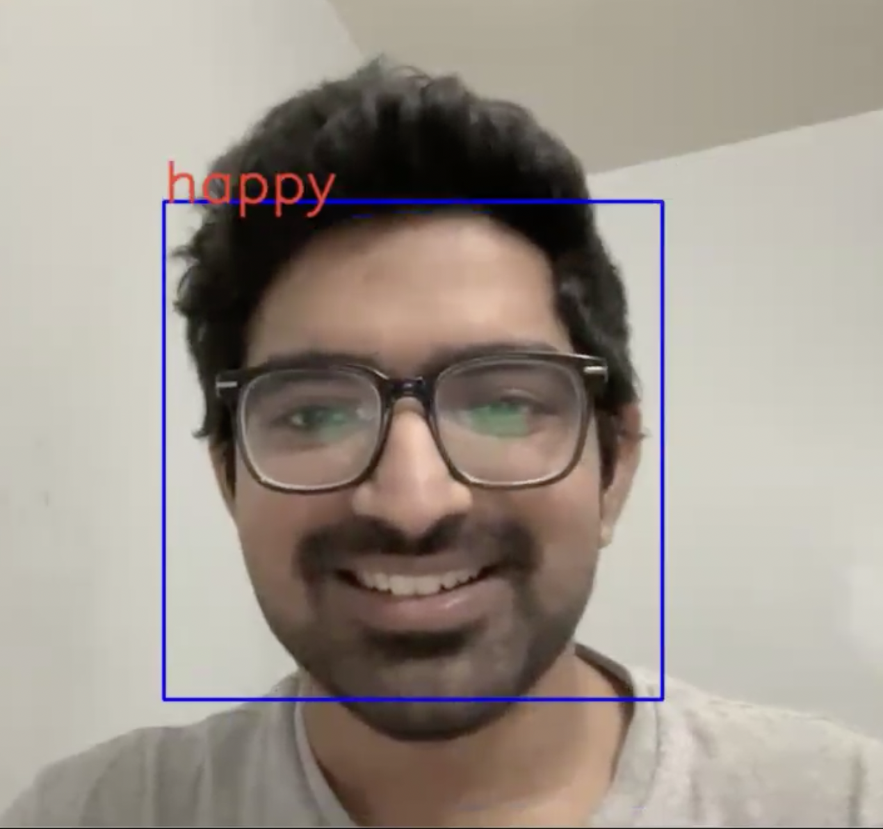
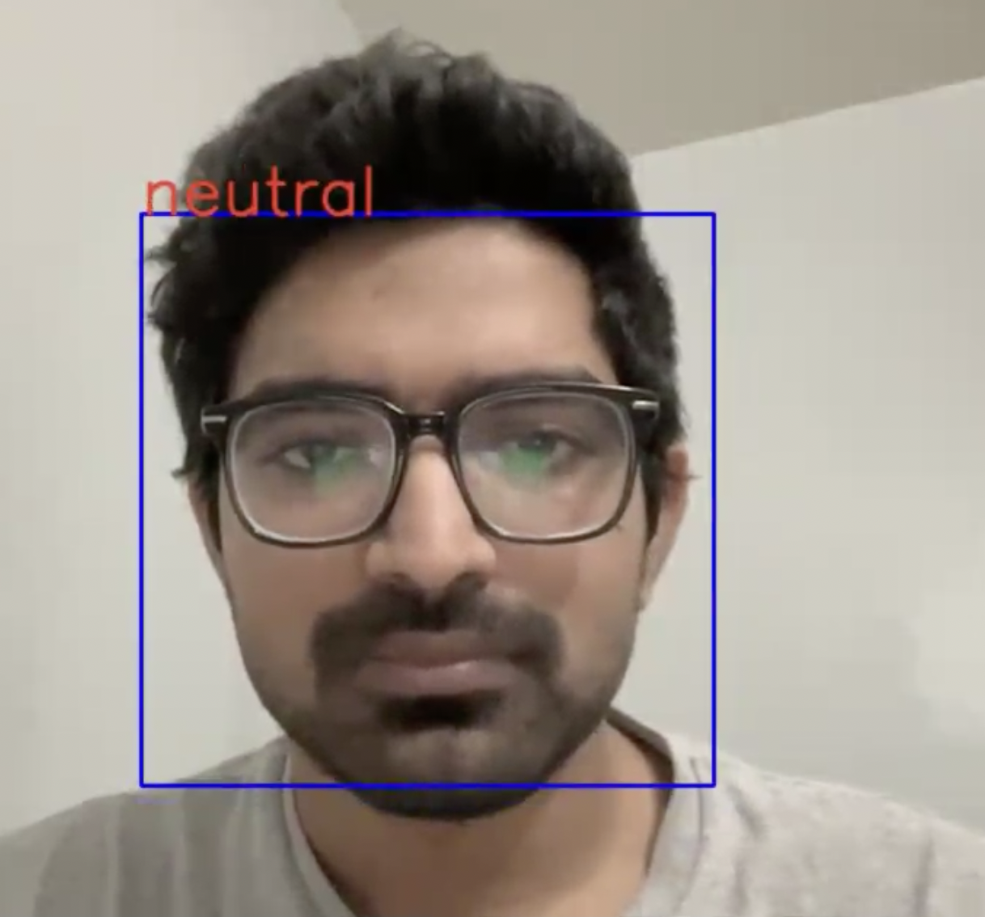
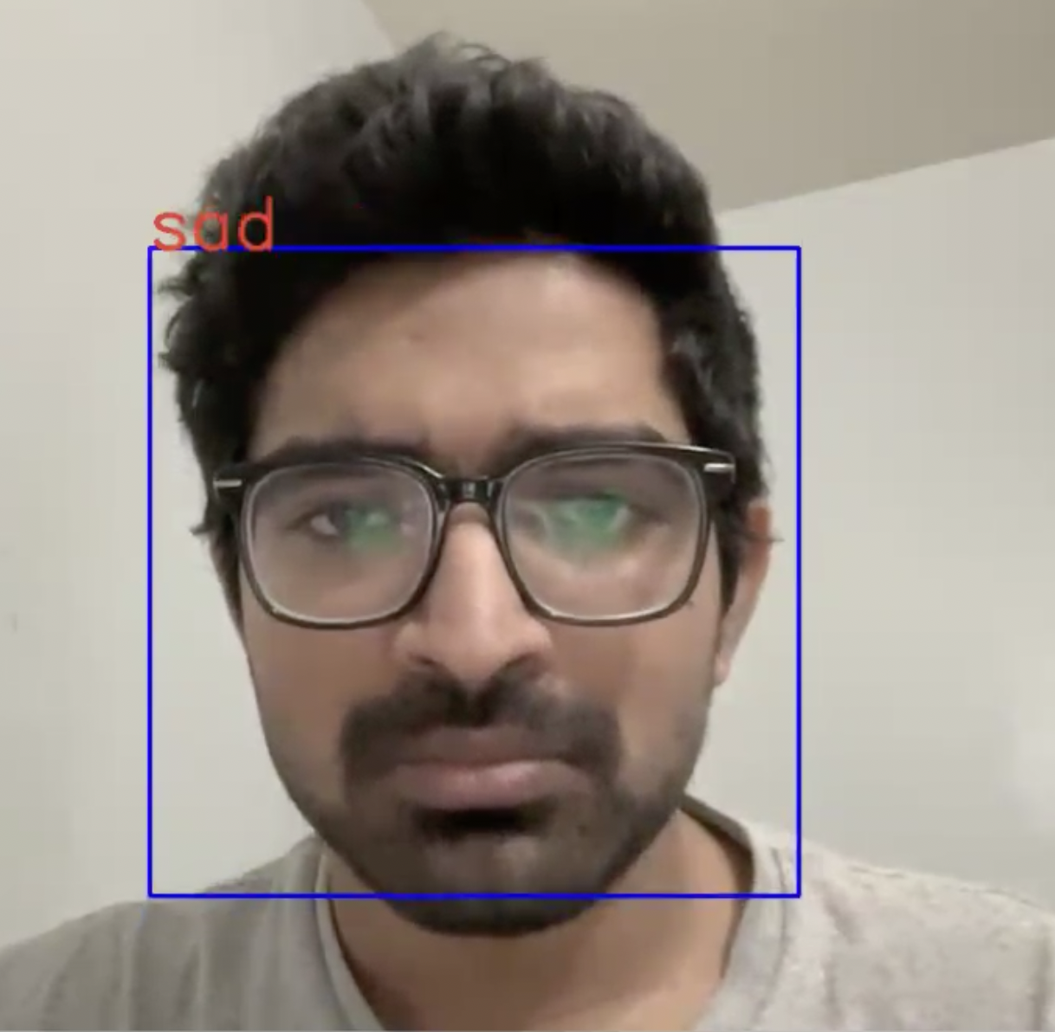
Results
Happy
Neutral
Sad

Slide 20
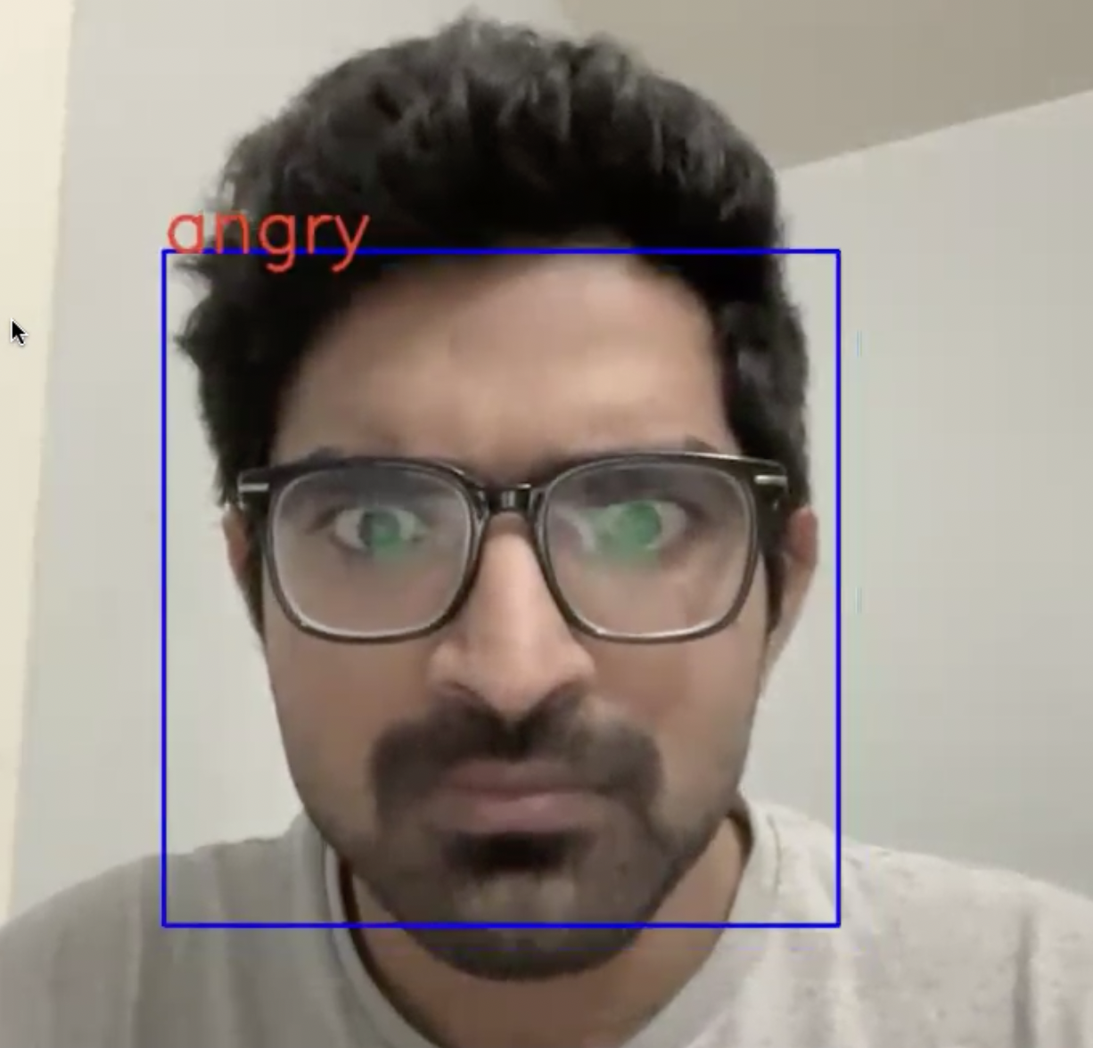
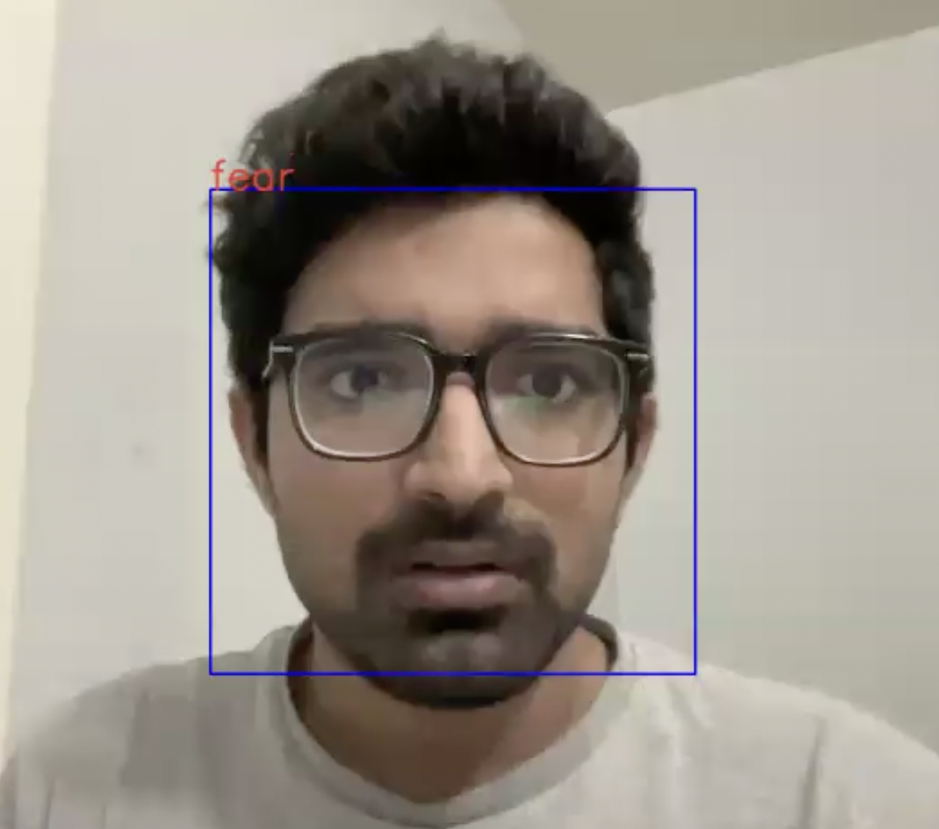
Results
Angry
Fear

Slide 21
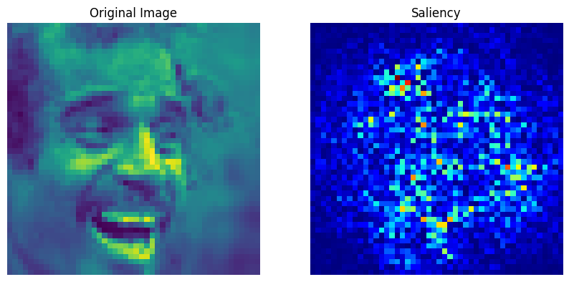
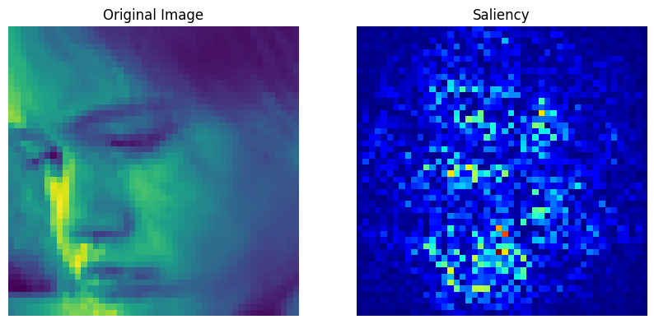
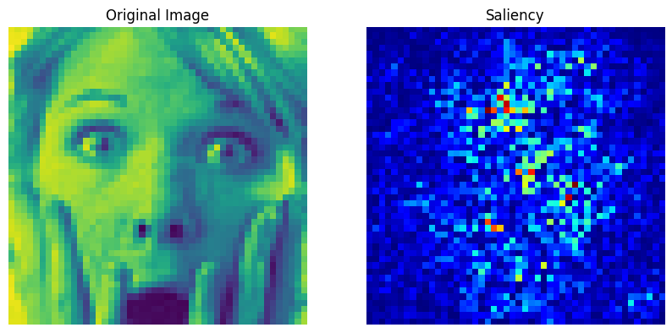
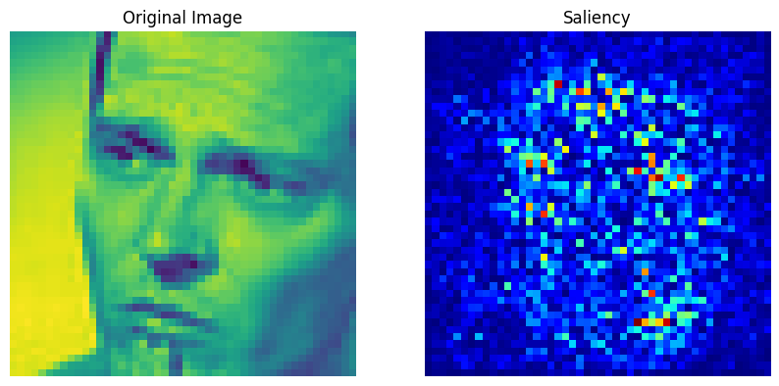
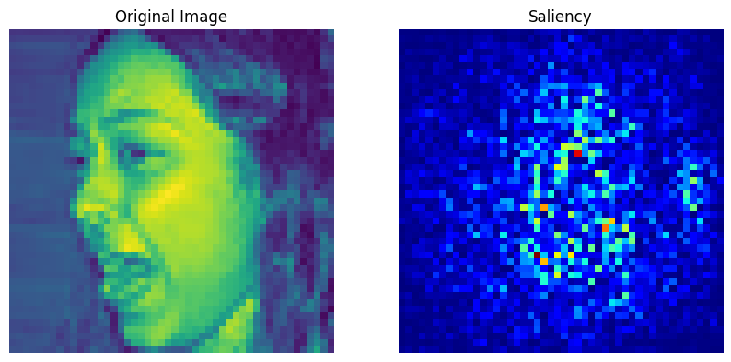
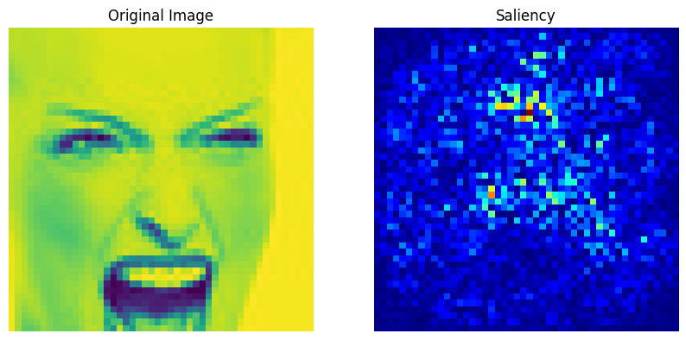
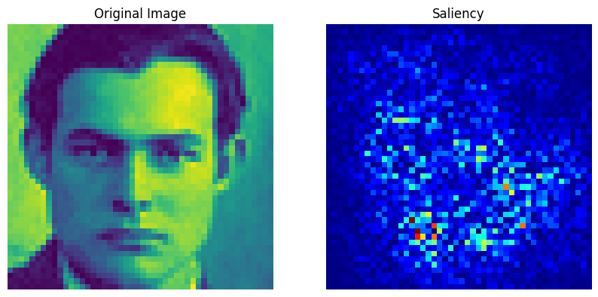
Saliency Maps

Slide 22
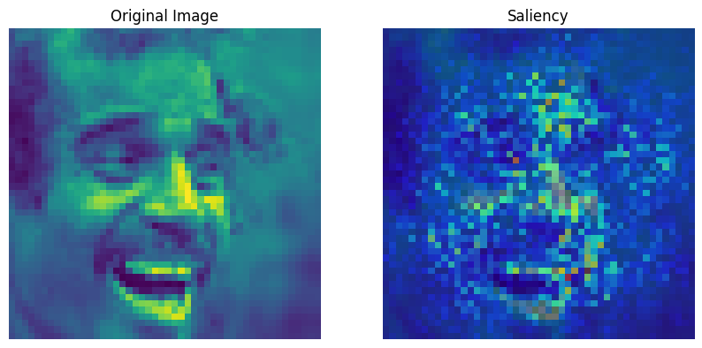
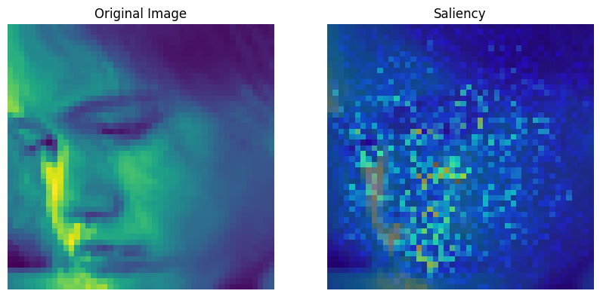
Saliency Maps
Saliency maps are visual representations that highlight regions in the input image that are most relevant for the model’s predictions.
The saliency maps shown here illustrate which parts of the face, such as the eyes, nose, and mouth, are pivotal for the model's emotion recognition task.

Slide 23
Conclusion
The combined VGG11, LSTM and attention-based model is designed to leverage both the spatial hierarchy within images and the temporal dynamics in sequences.​
The attention mechanism inclusion suggests the model's capacity to weigh different parts of the data sequence, potentially improving performance on tasks requiring focus on specific temporal features.​

Slide 24
References
Emotion Recognition from Facial Expressions using Deep Recurrent Attention Network
https://arxiv.org/pdf/1612.02903v1.pdf

Slide 25
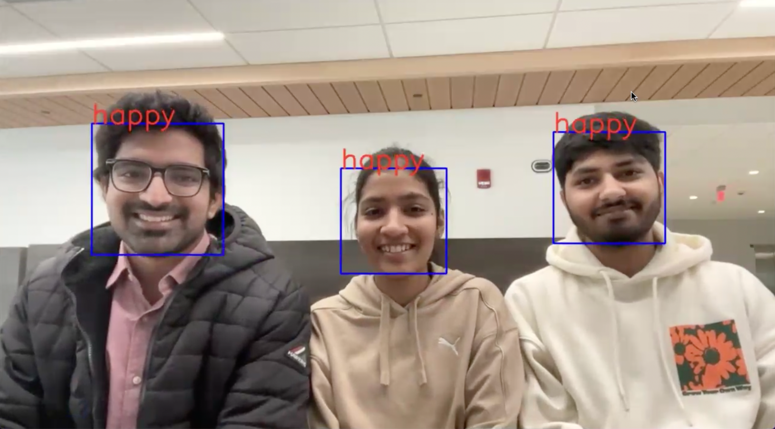
Thankyou

